Slide 1





Slide 2



2
About Me
Agenda
My Favorite Super Hero
London Stock Exchange Group (LSEG)
Capital Markets
ITIL
.
Importance of Application Support Engineer
Why I like this position
.
.

Slide 3
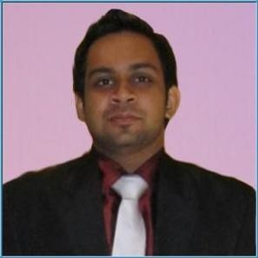


About Me
4
Hobbies & Personal Traits
Team player with ability to establish and nurture supportive and operative relationships with Managers & peers.
Excellent interpersonal and communication skills.
Adapt to environments very quickly.
Research & study on advancing IT technologies.
Ability to troubleshoot issues related to IT components and services .
Work Experience
Systems Engineer – Platform OS(May 2019 – March 2021) Pearson Lanka (pvt) ltd
Implementation Engineer (February 2017 – May 2019) Wavenet Solutions (pvt) ltd.
Technical support analyst (june 2016 – january 2017) paycorp international (pvt) ltd
.
Personal Profile
Full Name : Lahiru Hemanga Malavige
Nationality : Sri Lankan
Gender : Male
Date of Birth : 26th Aug 1992
Civil Status : Married
School Attended : Royal College, Colombo 07
Education
Master of information security
University of colombo school of computing
BSC IN IT (HONS) SPECIALIZED IN COMPUTER SYSTEMS AND NETWORKING sri lankan institute of information technology
RED HAT CERTIFIED ENGINEER certification no. 150-164-481

Slide 4

My Favorite Super Hero
When it comes to Superheroes, it’s not just their strength that matters. What matters is their dedication and contribution to change the world for greater good. Willingness to sacrifice themselves, and give hope to people.
My favorite super hero is Captain America.
He is not amongst the strongest of superheroes, but definitely he is a symbol of hope.
He never runs away from his problems or responsibilities.
His physical strength came from a Super-Soldier serum, but the bravery, intelligence, hard work and commitment he showed paved the way to become perfection from imperfection. That shows no matter what you are you need to believe in your self and work hard for towards good ambitions and it will be rewarded.
He personifies the best of the human spirit; he is the fictional embodiment of the human race as a whole, showing how we are capable of becoming a hero.

Slide 5



6
All the businesses which make up London Stock Exchange Group depend on technology, that should be secure, stable and performs to high levels of availability.
Cater the demands of a regulatory environment by means of seamless integration across businesses, enhancing products and services in a way that drives customer satisfaction and revenue.
LSEG Tec
Perform modifications to Millennium Exchange platform, which is configured to trade any product in any type of market.
Provide high level 24 x 7 support to carryout London Stock Exchange services with zero downtime.

Slide 6




35
Capital market is a market where buyers and sellers engage in trade of financial securities like bonds, stocks, etc.
Capital Markets
The buying/selling is undertaken by participants such as individuals and institutions. Generally, this market trades mostly in long-term securities.
LSEG offer their customers extensive access to capital markets and liquidity across multiple asset classes.
LSEG Group is home to several capital formation and execution venues: London Stock Exchange, AIM, Turquoise, CurveGlobal, FXall and Tradeweb.

Slide 7



15
ITIL is a framework of best practices for delivering IT services.
ITIL's systematic approach to IT service management can help businesses manage risk, strengthen customer relations, establish cost-effective practices, and build a stable IT environment that allows for growth, scale and change.
.
ITIL

Slide 8








18
IT professional
An Application Support Engineer is an IT professional who provides technical support regarding a spectrum of software used within a specific business sector.
Importance of Application Support Engineer
Team Player
Coordinate with teams and resolve all complex application and system issues. Design and maintain expertise in flow of application process and systems related to company..
Administer
As an Administer and problem solver, resolve applications issues, provide updates and perform root cause analysis

Slide 9

18
A transparent work culture.
The key to transparency at work is when leadership treats its employees as valued team members.
Why I like this position?
Flexibility
This is a key factor in happiness at work and both employees and employers alike are waking up to the importance and benefits of flexible working..
Opportunities for career growth
To really love our jobs, we need to feel that we have prospects for growth and development – both in terms of moving up the career ladder, but also on a personal level too which can come in the form of experiential growth such as travel.
Positive accountability
Feeling in control of our lives makes us happy – and it has been proven that this is true of the workplace too.
Goal Oriented

Slide 10






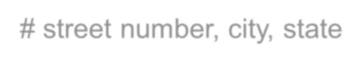
THANK
39
Address:
No: 51, Sunethra Devi Road, Kohuwala
Contact Number:
+94 11 2818511 (Residence) /+94 71 2089822 (Mobile)
Email Address:
lahirumalavige@gmail.com

